Slide 1
Project No.29
The Code Breakers: A Decentralized Blockchain Marketplace

Slide 2
A blockchain solution for secure data transactions
Team name: The Code Breakers
Project Description: A blockchain-based platform allowing users to buy, sell, and upload data securely using Ethereum.
Key Features:
Decentralized marketplace
Secure transactions via Ethereum
User-friendly interface for seamless interactions
Notes:
Context:
In an era dominated by Big Data, obtaining datasets with specific parameters is challenging, especially in fields like healthcare.
Our project addresses this issue by enabling a decentralized, secure data marketplace powered by blockchain technology.
What we built:
A blockchain-based platform that allows users to upload, buy, and sell data using Ethereum cryptocurrency.
Our aim: simplify access to valuable data while ensuring security and decentralization.
Why we built it:
Centralized data systems are prone to issues like security vulnerabilities and lack of transparency.
We leverage Ethereum to build a marketplace for trustless, efficient data transactions.

Slide 3
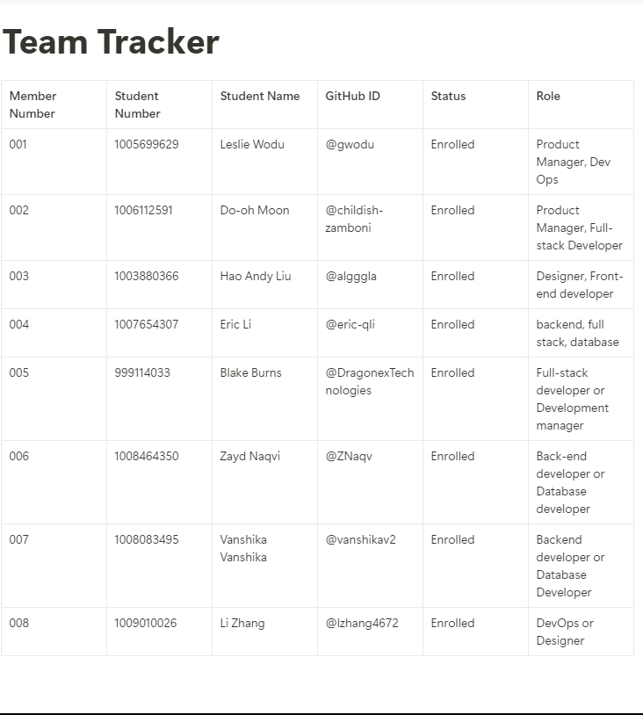
Team Members
Notion: https://www.notion.so/Team-Tracker-107fedce4cdf804a900ae9e99f7f9a4f

Slide 4
Live Demo

Slide 5
Technical Discussion (Code Architecture)
Code Architecture Overview
Content
Backend: Node.js with MongoDB
Frontend: HTML5, CSS3, JavaScript
Blockchain: Solidity smart contracts for Ethereal
Agile workflow practices:
Weekly meetings: Discord
Task tracking via ClickUp: https://app.clickup.com/9011332671/v/o/s/90111325774 ( Nothing on it so shud we still add it??)
Code submission and review using Github: https://github.com/csc301-2024-f/project-23-the-code-breakers

Slide 6
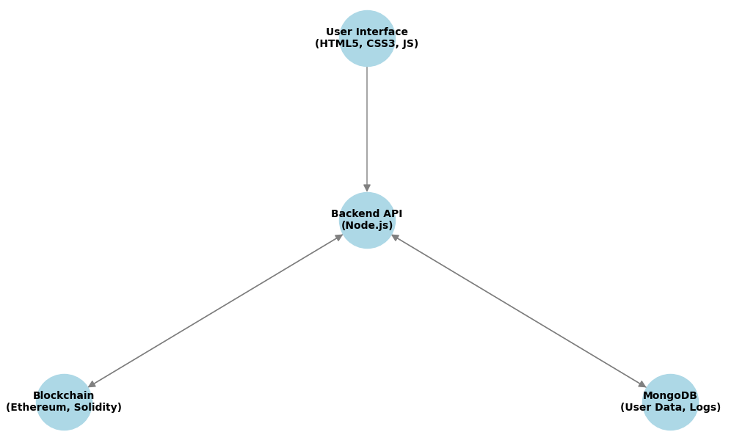

Slide 7
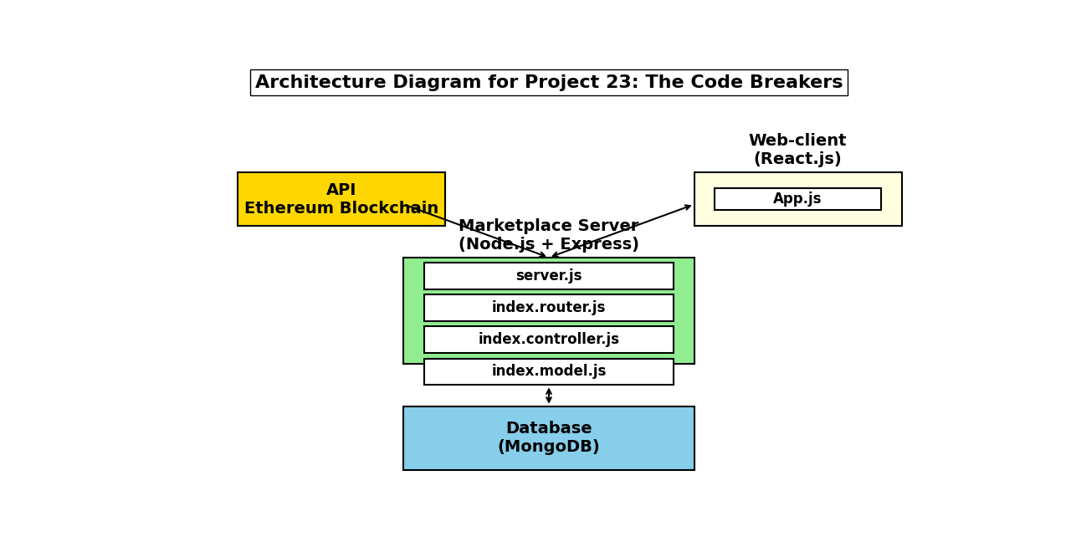

Slide 8
Accessing the Application
User Access and Application Workflow
Screenshots of:
Registration page
Marketplace page
Access Instructions:
Install Node.js and MongoDB
Configure MongoDB and directory setup
Run Node.js to start the application
Link to the GitHub repository for detailed setup

Slide 9
Key Learnings
Challenges faced:
Integrating blockchain with a traditional web interface
Ensuring decentralized data security
Solutions adopted:
Agile workflows for effective collaboration
Extensive use of comments and documentation for clarity
Development takeaways:
Importance of coding standards
Collaboration tools enhancing productivity.

Slide 10
Testing Instructions
Reference subteam reports (D2 23.2: Ethereum Backend, D2 23.2: Database):
Add clear steps for testing:
Smart contract testing
Backend API testing
Integration testing between blockchain and database
Specify required testing tools and environments:
Node.js, Truffle for Ethereum
MongoDB for database verification.

